Slide 1




cognfyiz Internship
Restaurant
Analysis
Presentations are communication tools that can be used as demonstrations.
Presentations are communication tools that can be used as demonstrations.
02
Marketing Plan

Slide 2

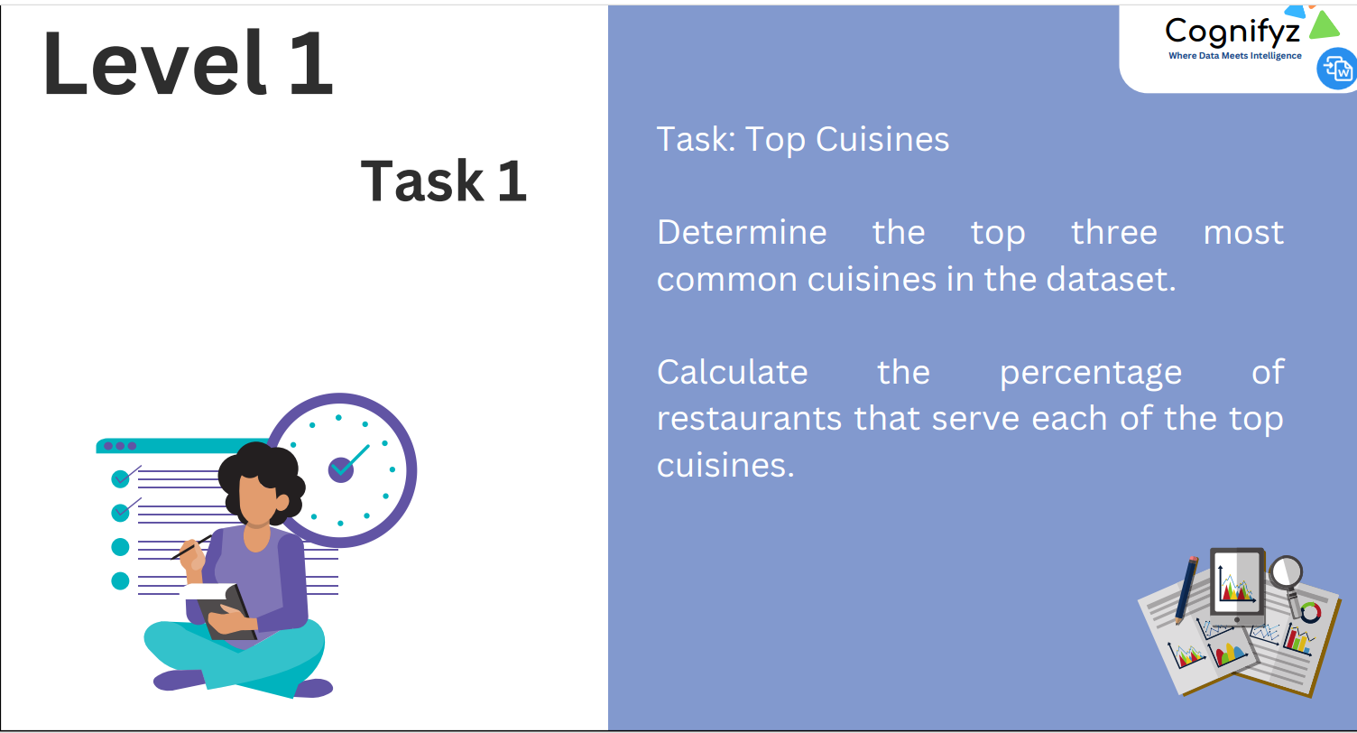

CONTENTS
01.
01
02.
02
Marketing Strategy
Audience
Presentations are communication tools that can be used as demonstrations.
Presentations are communication tools that can be used as demonstrations.
03.
03
04.
04
Budget & Roadmap
Summary
Presentations are communication tools that can be used as demonstrations.
Presentations are communication tools that can be used as demonstrations.
Roadmap

Slide 3
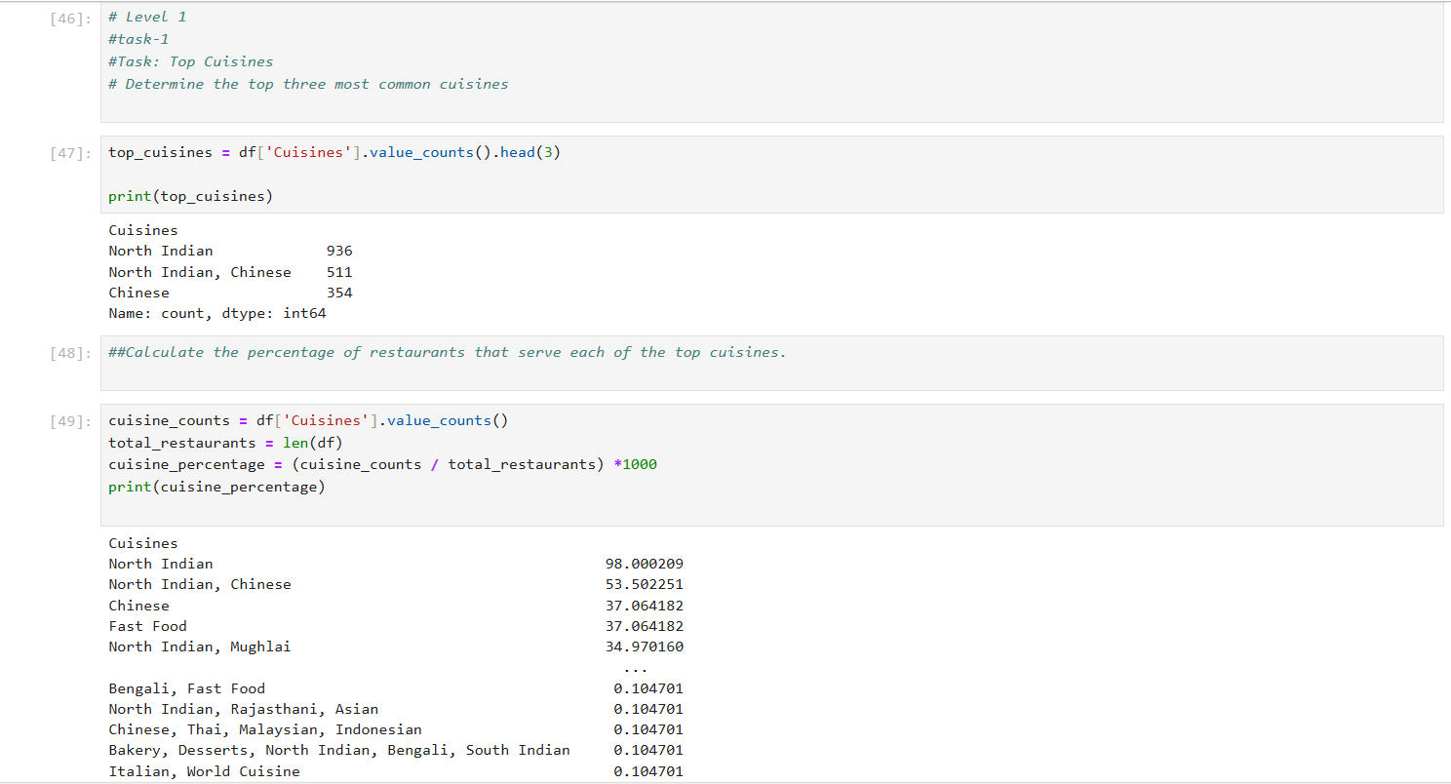

Slide 4
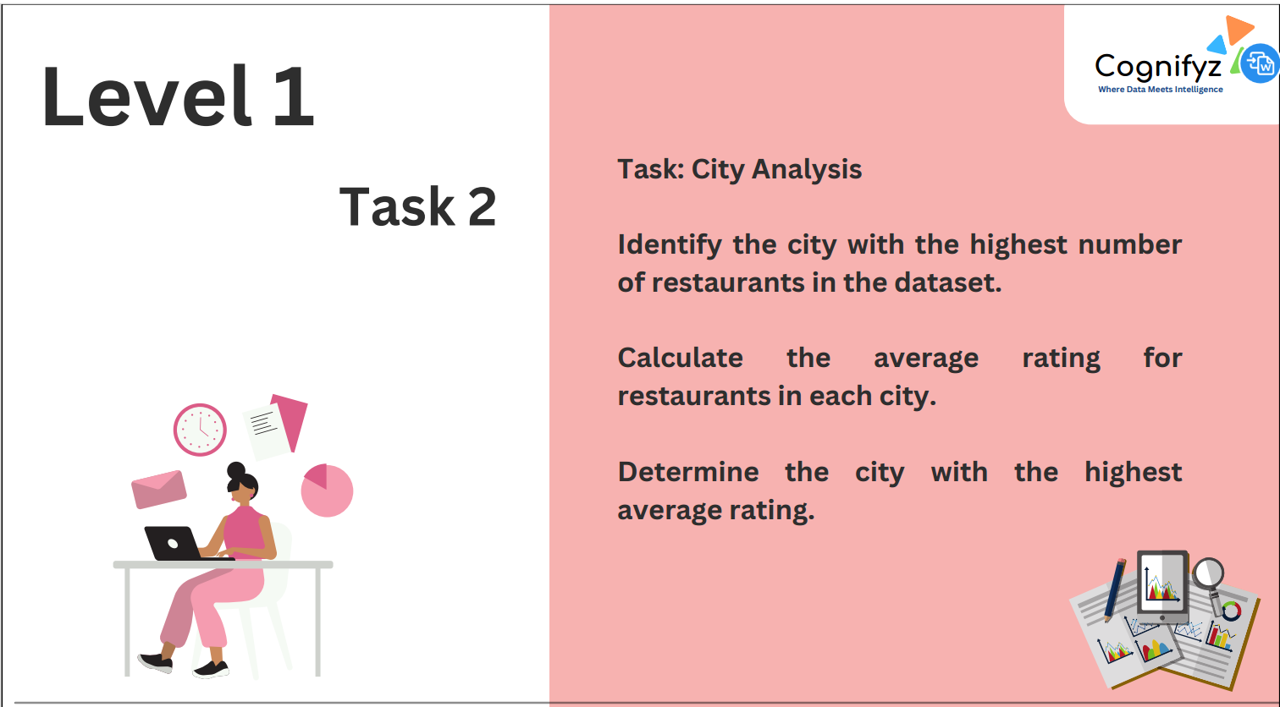


Slide 5
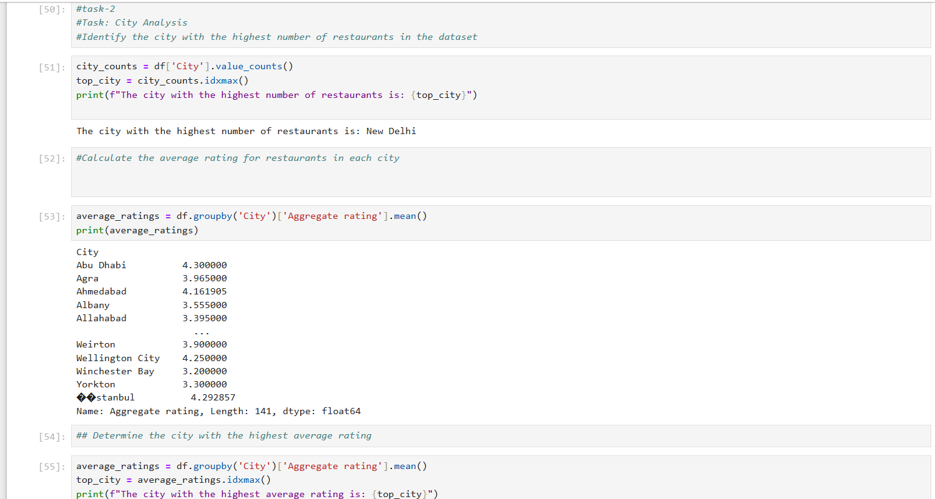

Slide 6
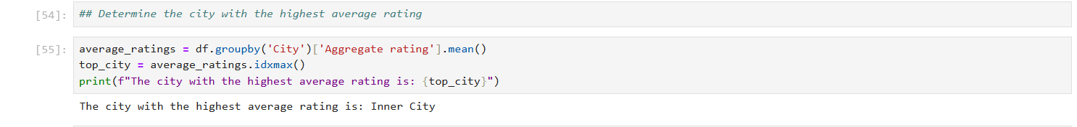


Slide 7
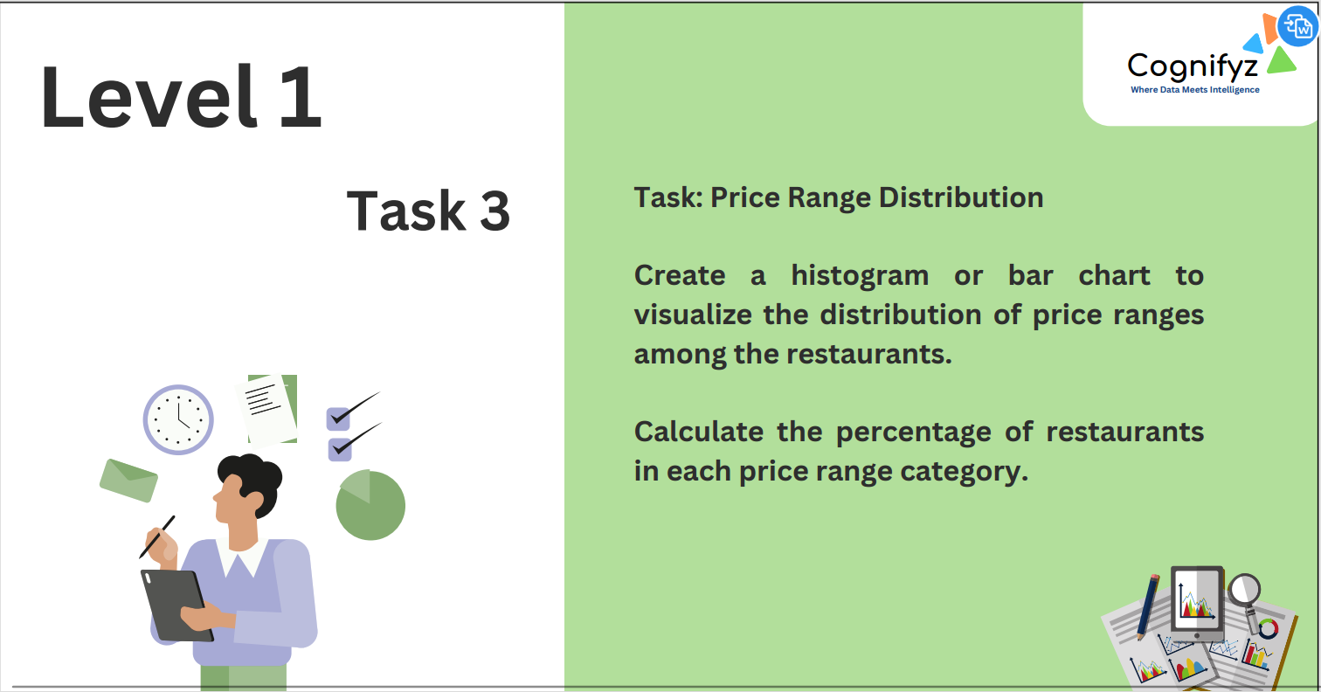

Slide 8
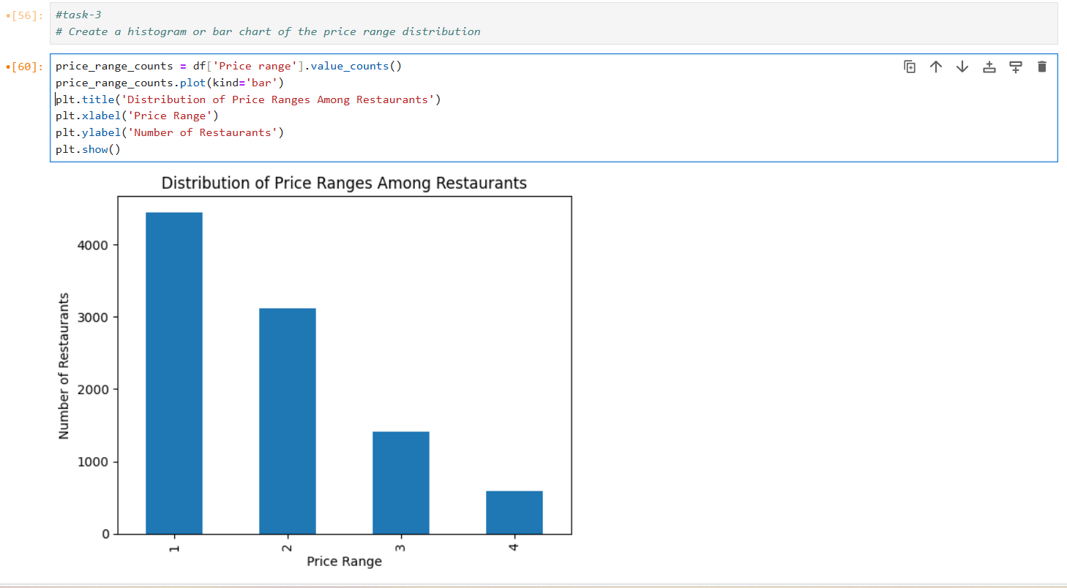

Slide 9
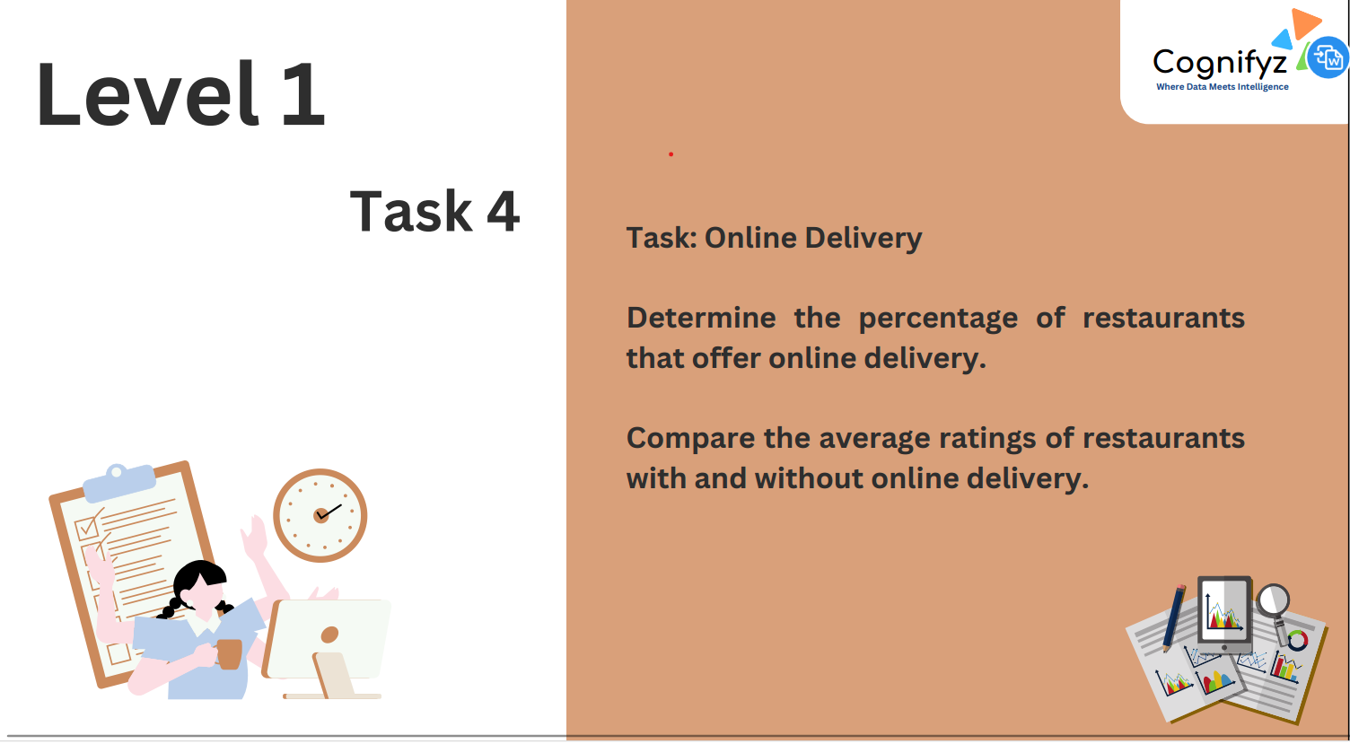

Slide 10
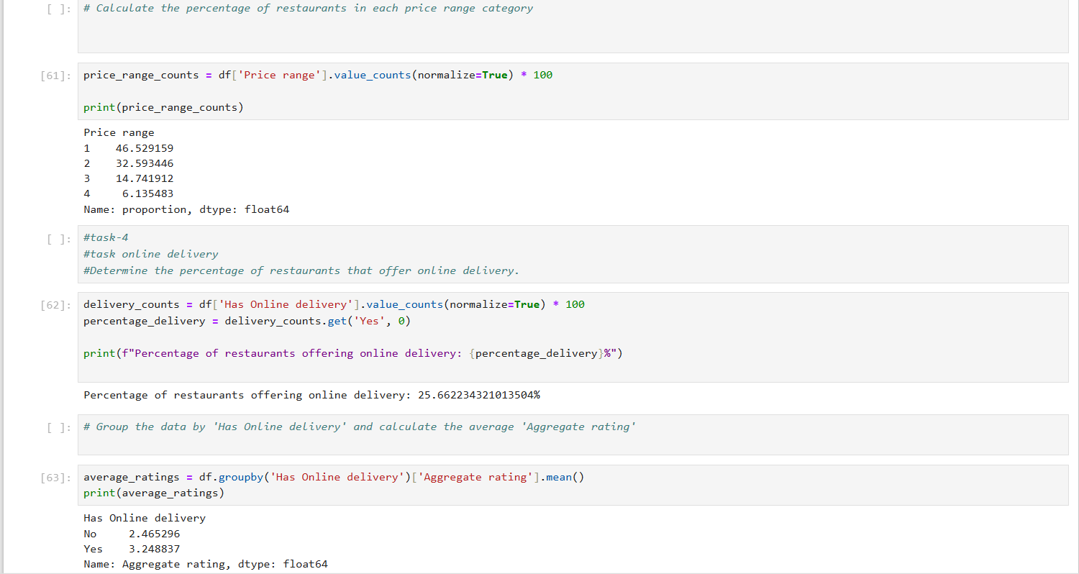

Slide 11
THANKS
FOR
WATCHING

